Slide 1
4. The Visual Basic Language
Database Access and Management
Prof Yousef B.Mahdy

Slide 2
Introduction
A major change in Visual Basic, with the introduction of Version 6.0, is in its database management tools. New tools based on ActiveX Data Object (ADO) technology have been developed. These new tools will eventually replace the older database tools, called DAO (Data Access Object) tools. We will only discuss the ADO tools. Microsoft still includes the DAO tools for backward compatibility. You might want to study these on your own, if desired.

Slide 3

Database Structure and Terminology
In our first example, we will use a sample database that comes with Visual Basic. This database (BIBLIO.MDB) is found in the main Visual Basic directory (try c:\Program Files\Microsoft Visual Studio\VB98). It is a database of books about computers. Let’s look at its relational structure. The BIBLIO.MDB database is made up of four tables:

Slide 4
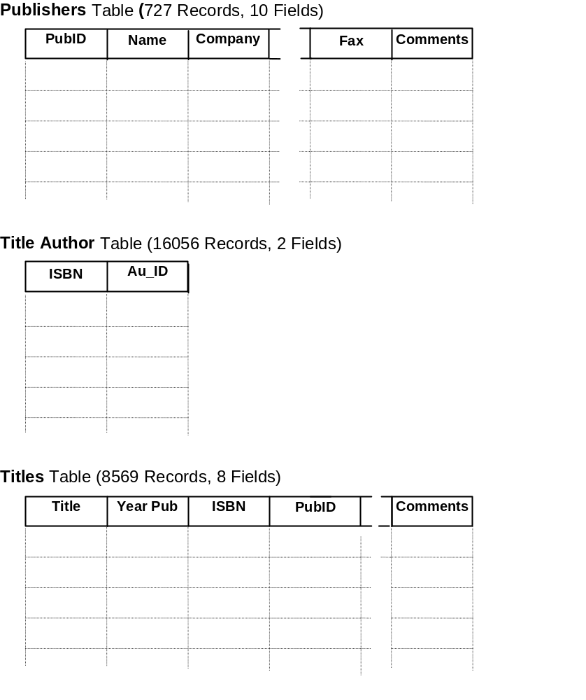
Database Structure and Terminology

Slide 5
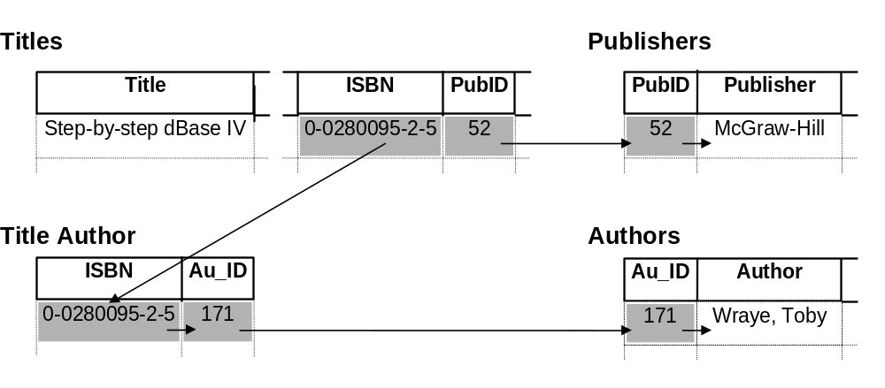
Database Structure and Terminology
Using the relational data in the four tables, we should be able to obtain a complete description of any book title in the database. Let’s look at one example:
Here, the book in the Titles table, entitled “Step-by-step dBase IV,” has an ISBN of 0-0280095-2-5 and a PubID of 52. Taking the PubID into the Publishers table, determines the book is published by McGraw-Hill and also allows us to access all other information concerning the publisher. Using the ISBN in the Title Author table provides us with the author identification (Au_ID) of 171, which, when used in the Authors table, tells us the book’s author is Toby Wraye.

Slide 6
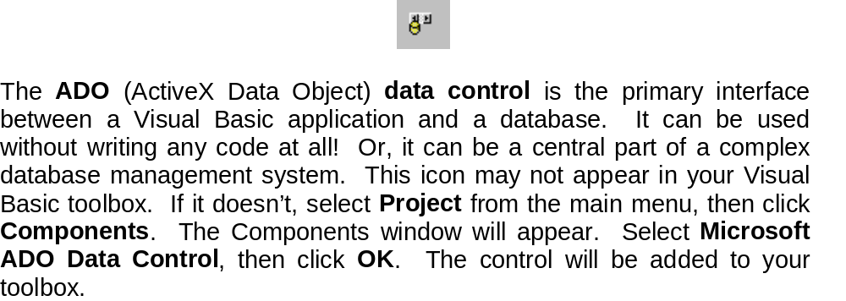
ADO Data Control

Slide 7
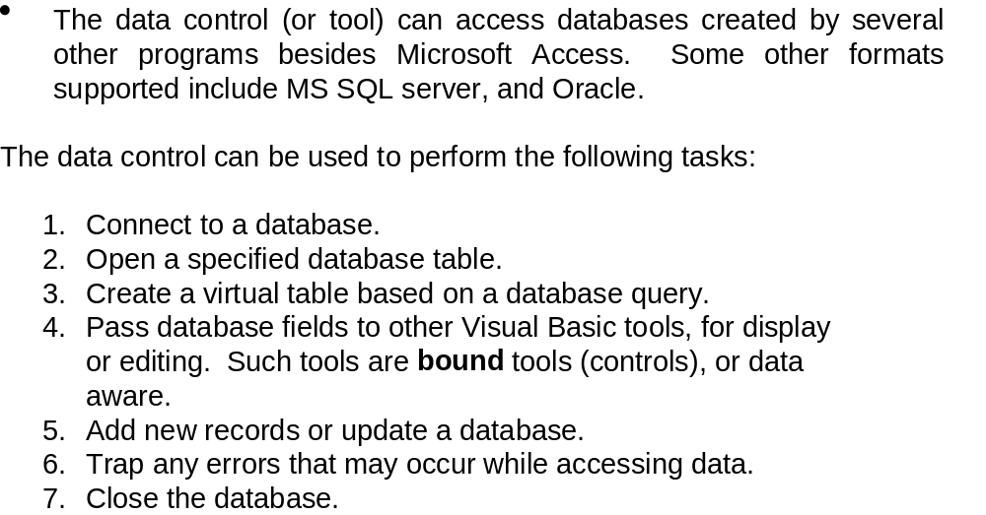
ADO Data Control

Slide 8
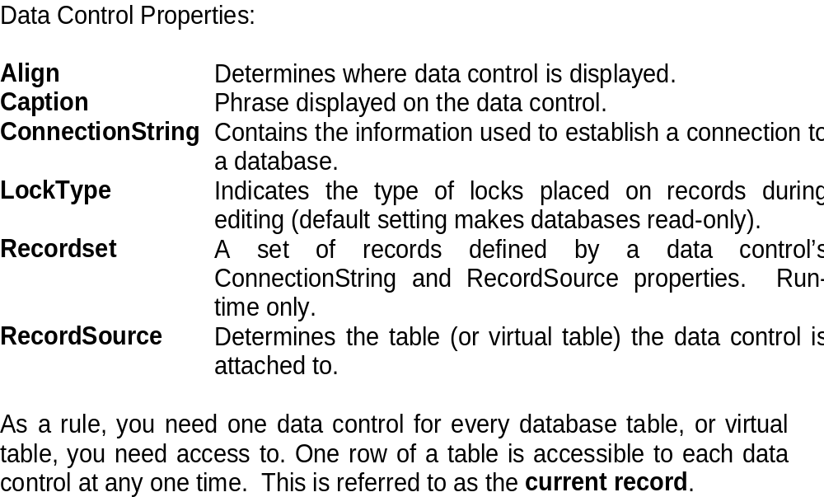
ADO Data Control

Slide 9
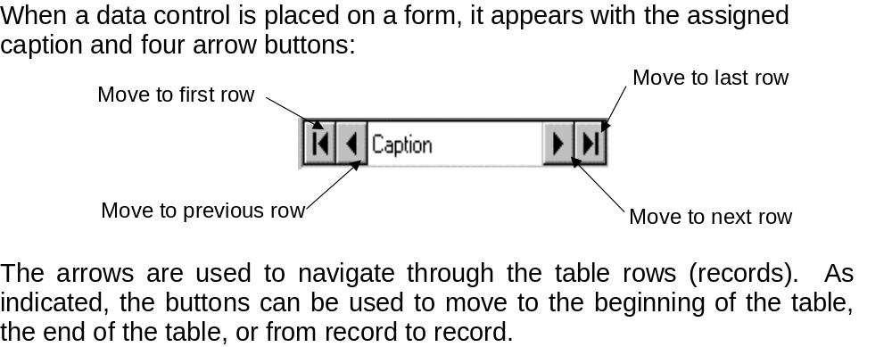
ADO Data Control

Slide 10
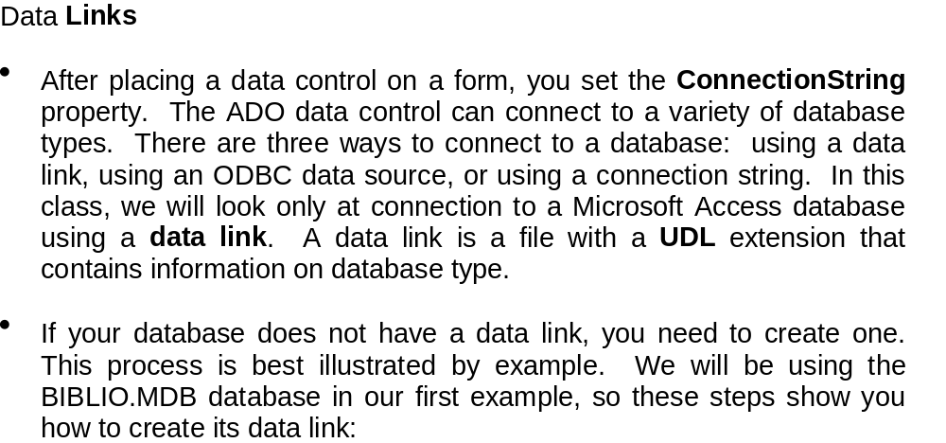
ADO Data Control

Slide 11
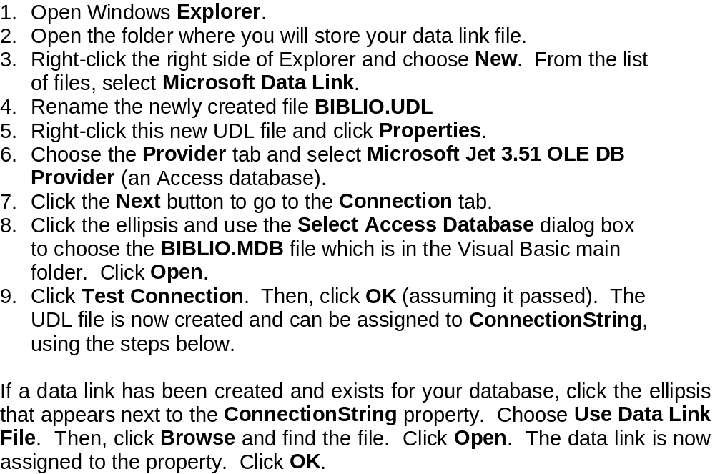
ADO Data Control -MSDASC.DLL

Slide 12
ADO Data Control
Assigning Tables
Once the ADO data control is connected to a database, we need to assign a table to that control. Recall each data control is attached to a single table, whether it is a table inherent to the database or the virtual table we discussed. Assigning a table is done via the RecordSource property.
Tables are assigned by making queries of the database. A table is assigned by placing a valid SQL statement in the RecordSource property of a data control. We won’t be learning any SQL here. There are many texts on the subject - in fact, many of them are in the BIBLIO.MDB database we’ve been using. Here we simply show you how to use SQL to have the data control ‘point’ to an inherent database table.
Click on the ellipsis next to RecordSource in the property box. A Property Pages dialog box will appear. In the box marked Command Text (SQL), type this line:
SELECT * FROM TableName
Setting the RecordSource property also establishes the Recordset property, which we will see later is a very important property.

Slide 13
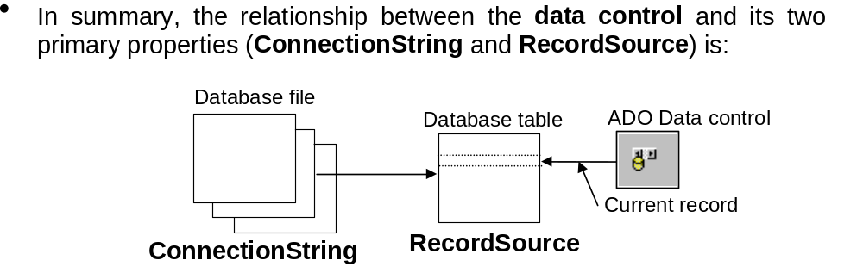
ADO Data Control

Slide 14
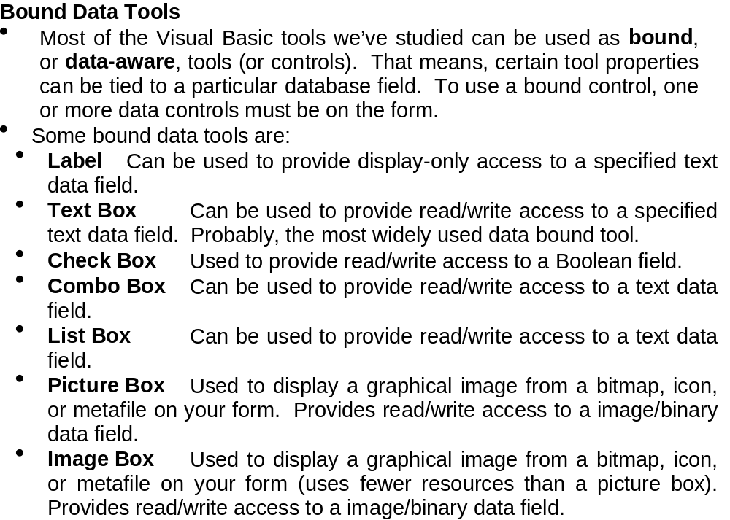
ADO Data Control

Slide 15
ADO Data Control
Bound Tool Properties:
  DataChanged Indicates whether a value displayed in a bound control has changed.
  DataField Specifies the name of a field in the table pointed to by the respective data control.
  DataSource Specifies which data control the control is bound to.
If the data in a data-aware control is changed and then the user changes focus to another control or tool, the database will automatically be updated with the new data (assuming LockType is set to allow an update).

Slide 16
ADO Data Control
To make using bound controls easy, follow these steps (in order listed) in placing the controls on a form:
  Draw the bound control on the same form as the data control to which it will be bound.
  Set the DataSource property. Click on the drop-down arrow to list the data controls on your form. Choose one.
  Set the DataField property. Click on the drop-down arrow to list the fields associated with the selected data control records. Make your choice.
  Set all other properties, as required.

Slide 17
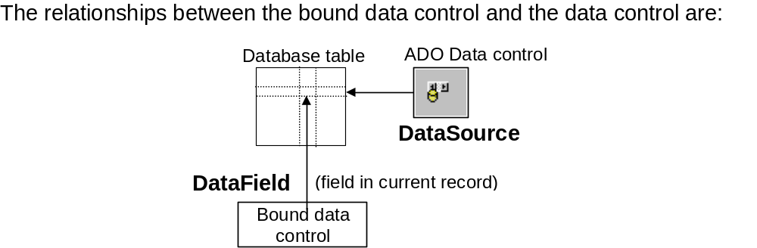
ADO Data Control

Slide 18
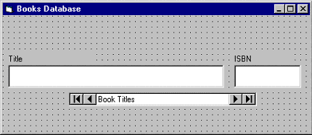
Accessing the Books Database
Adodc1:
  Caption Book Titles
  ConnectionString BIBLIO.UDL (select, don’t type)
  RecordSource SELECT * FROM Titles
  Name dtaTitles

Slide 19
Accessing the Books Database
Text1:
  DataSource dtaTitles (select, don’t type)
  DataField Title (select, don’t type)
  Locked True
  MultiLine True
  Name txtTitle
  Text [Blank]

Slide 20
Finding Specific Records
In addition to using the data control to move through database records, we can write Visual Basic code to accomplish the same, and other, tasks. This is referred to as programmatic control. In fact, many times the data control Visible property is set to False and all data manipulations are performed in code. We can also use programmatic control to find certain records.
There are four methods used for moving in a database. These methods replicate the capabilities of the four arrow buttons on the data control:
  MoveFirst Move to the first record in the table.
  MoveLast Move to the last record in the table.
  MoveNext Move to the next record (with respect to the current record) in the table.
  MovePrevious Move to the previous record (with respect to the current record) in the table.

Slide 21
Finding Specific Records
When moving about the database programmatically, we need to test the BOF (beginning of file) and EOF (end of file) properties. The BOF property is True when the current record is positioned before any data. The EOF property is True when the current record has been positioned past the end of the data. If either property is True, the current record is invalid. If both properties are True, then there is no data in the database table at all.
These properties, and the programmatic control methods, operate on the Recordset property of the data control. Hence, to move to the first record in a table attached to a data control named dtaExample, the syntax is:
    dtaExample.Recordset.MoveFirst
There is a method used for searching a database:
Find: Find a record that meets the specified search criteria. This method also operates on the Recordset property and has three arguments we will be concerned with. To use Find with a data control named dtaExample:

Slide 22
Finding Specific Records
dtaExample.Recordset.Find Criteria,NumberSkipped,SearchDirection
The search Criteria is a string expression like a WHERE clause in SQL.
Criteria = “Title >= ‘S’”
Note the use of single quotes around the search letter. Single quotes are used to enclose strings in Criteria statements. Three logical operators can be used: equals (=), greater than (>), and less than (<).
The NumberSkipped argument tells how many records to skip before beginning the Find. This can be used to exclude the current record by setting NumberSkipped to 1.
The SearchDirection argument has two possible values: adSearchForward or adSearchBackward. Note, in conjunction with the four Move methods, the SearchDirection argument can be used to provide a variety of search types (search from the top, search from the bottom, etc.)
If a search fails to find a record that matches the criteria, the Recordset’s EOF or BOF property is set to True (depending on search direction). Another property used in searches is the Bookmark property. This allows you to save the current record pointer in case you want to return to that position later.

Slide 23
‘Rolodex’ Searching of the Books Database
We expand the book database application to allow searching for certain author names. We’ll use a ‘rolodex’ approach where, by pressing a particular letter button, books with author last names corresponding to that button appear on the form.
We want a row of buttons starting at ‘A’ and ending at ‘Z’ to appear on the lower part of our form. Drawing each one individually would be a big pain, so we’ll let Visual Basic do all the work in the Form_Load procedure. What we’ll do is create one command button (the ‘A’), make it a control array, and then dynamically create 25 new control array elements at run-time, filling each with a different letter. We’ll even let the code decide on proper spacing.

Slide 24
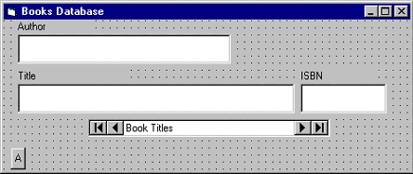
‘Rolodex’ Searching of the Books Database
Private Sub Form_Load()
Dim I As Integer
‘Size buttons
cmdLetter(0).Width = (frmBooks.ScaleWidth - 2* cmdLetter(0).Left) / 26
For I = 1 To 25
Load cmdLetter(I) ' Create new control array element
'Position new letter next to previous one
cmdLetter(I).Left = cmdLetter(I - 1).Left + cmdLetter(0).Width
'Set caption and make visible
cmdLetter(I).Caption = Chr(vbKeyA + I)
cmdLetter(I).Visible = True
Next I
End Sub

Slide 25
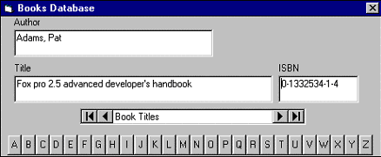
‘Rolodex’ Searching of the Books Database

Slide 26
‘Rolodex’ Searching of the Books Database
Private Sub cmdLetter_Click(Index As Integer)
Dim BookMark1 As Variant
'Mark your place in case no match is found
BookMark1 = dtaTitles.Recordset.Bookmark
'Move to top of table to start search
dtaTitles.Recordset.MoveFirst
dtaTitles.Recordset.Find "Author >= '" + cmdLetter(Index).Caption + "'", 0, adSearchForward
If dtaTitles.Recordset.EOF = True Then
dtaTitles.Recordset.Bookmark = BookMark1
End If
txtAuthor.SetFocus
End Sub

Slide 27
Database Management
We will develop a simple DBMS. It will allow us to view records in an existing database. We will be able to edit records, add records, and delete records. Such advanced tasks as adding tables and fields to a database and creating a new database can be done with Visual Basic.
To create our DBMS, we need to define a few more programmatic control methods associated with the data control Recordset property. These methods are:
  AddNew: A new record is added to the table. All fields are set to Null and this record is made the current record.
  Delete :The current record is deleted from the table. This method must be immediately followed by one of the Move methods because the current record is invalid after a Delete.
  Update :Saves the current contents of all bound tools.

Slide 28
Database Management
To edit an existing record, you simply display the record and make any required changes. The LockType property should be set to adLockPessimistic (locks each record as it is edited). Then, when you move off of that record, either with a navigation button or through some other action, Visual Basic will automatically update the record. If desired, or needed, you may invoke the Update method to force an update (use LockType = asLockOptimistic). For a data control named dtaExample, the syntax for this statement is:
  dtaExample.Recordset.Update
To add a record to the database, we invoke the AddNew method. The syntax for our example data control is:
  dtaExample.Recordset.AddNew
This statement will blank out any bound data tools and move the current record to the end of the database. At this point, you enter the new values. When you move off of this record, the changes are automatically made to the database. Another way to update the database with the changes is via the Update method.
After adding a record to a database, you should invoke the Refresh property of the data control to insure proper sorting (established by RecordSource SQL statement) of the new entry. The format is:
  dtaExample.Refresh

Slide 29
Database Management
To delete a record from the database, make sure the record to delete is the current record. Then, we use the Delete method. The syntax for the example data control is:
  dtaExample.Recordset.Delete
Once we execute a Delete, we must move (using one of the ‘Move’ methods) off of the current record because it no longer exists and an error will occur if we don’t move. This gets particularly tricky if deleting the last record (check the EOF property). If EOF is true, you must move to the top of the database (MoveFirst). You then must make sure there is a valid record there (check the BOF property). The example code demonstrates proper movement.

Slide 30
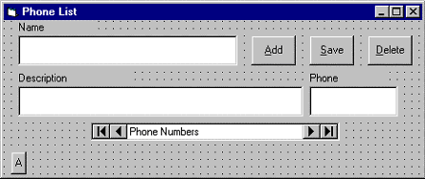
Example 8-4

Slide 31
Add
Private Sub cmdAdd_Click()
cmdAdd.Enabled = False
cmdSave.Enabled = True
cmdDelete.Enabled = False
dtaPhone.Recordset.AddNew
txtName.SetFocus
End Sub

Slide 32
Save
Private Sub cmdSave_Click()
dtaPhone.Recordset.Update
dtaPhone.Refresh
cmdAdd.Enabled = True
cmdSave.Enabled = False
cmdDelete.Enabled = True
txtName.SetFocus
End Sub

Slide 33
Delete
Private Sub cmdDelete_Click()
dtaPhone.Recordset.Delete
dtaPhone.Recordset.MoveNext
If dtaPhone.Recordset.EOF = True Then
dtaPhone.Refresh
If dtaPhone.Recordset.BOF = True Then
MsgBox "You must add a record.", vbOKOnly + vbInformation, "Empty file"
Call cmdAdd_Click
Else
dtaPhone.Recordset.MoveFirst
End If
End If
txtName.SetFocus
End Sub

Slide 34
Creating a Data Report
Once you have gone to all the trouble of developing and managing a database, it is nice to have the ability to obtain printed or displayed information from your data. The process of obtaining such information is known as creating a data report.
There are two steps to creating a data report. First, we need to create a Data Environment. This is designed within Visual Basic and is used to tell the data report what is in the database. Second, we create the Data Report itself. This, too, is done within Visual Basic. The Data Environment and Data Report files then become part of the Visual Basic project developed as a database management system.
The Visual Basic 6.0 data report capabilities are vast and using them is a detailed process. The use of these capabilities is best demonstrated by example. We will look at the rudiments of report creation by building a tabular report for our phone database.

Slide 35
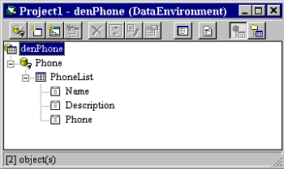
Creating a Data Environment

Slide 36
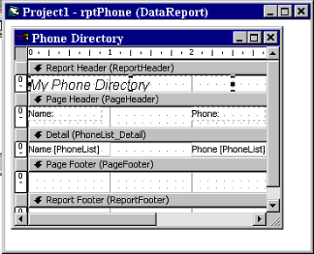
Creating a Data Report

Slide 37
Accessing the Data Report
Private Sub cmdReport_Click()
rptPhone.Show
End Sub

Slide 38
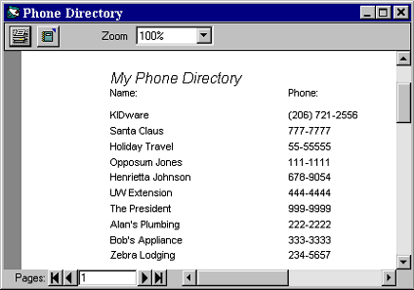
Accessing the Data Report

Slide 39
Home Inventory Database
Design and develop an application that manages a home inventory database. Add the option of obtaining a printed list of your inventoried property.
The first step is to design a database using Data Manager (or Access). My database is a single table (named MYSTUFF). Its specifications are:
Field Name Field Type Field Length
Item Text 40
Serial Number Text 20
Date Purchased Text 20
New Value Currency <N/A>
Location Text 40

Slide 40
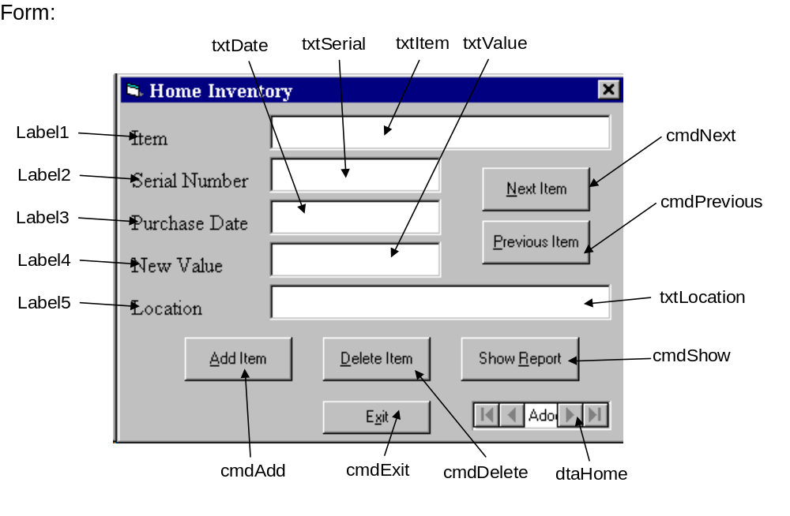
GUI

Slide 41
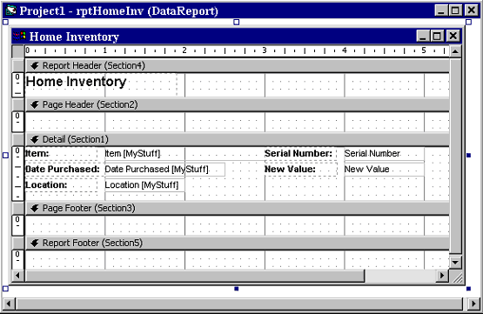
Report

